Slide 1
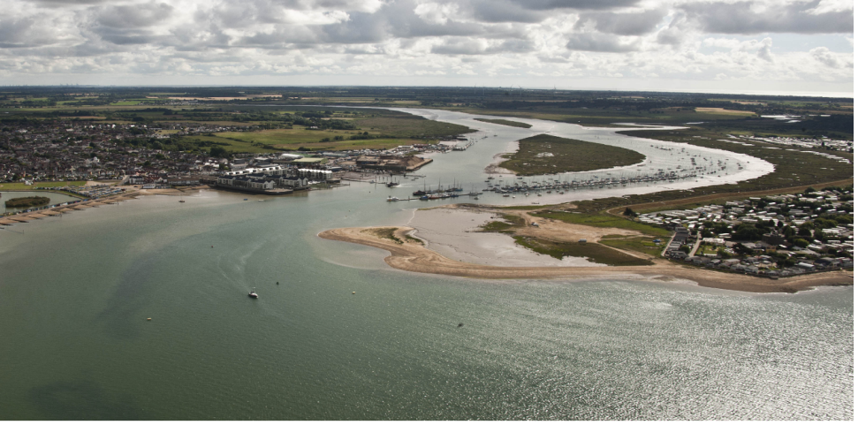
Using sediment as a resource
Brightlingsea Harbour
Image: courtesy of Brightlingsea Harbour
USAR - Using Sediment As a Resource

Slide 2
Using sediment as a resource
Progress
Permits and licences obtained
Materials delivered
Main Channel Dredged
Monitoring, surveys and studies underway
Trial commenced
Using Sediment As A Resource

Slide 3
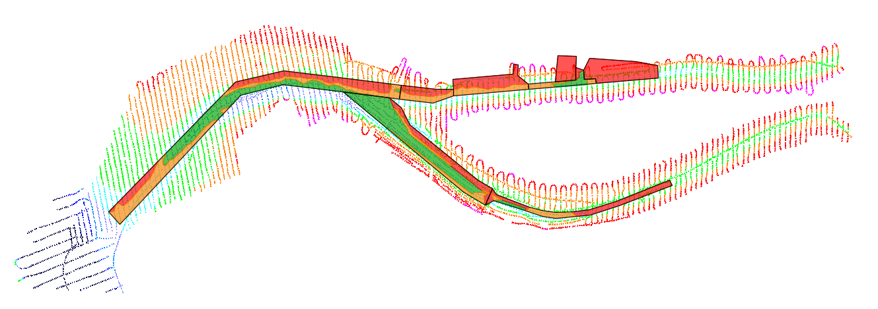
Using sediment as a resource
Dredging sites
Using Sediment As A Resource

Slide 4
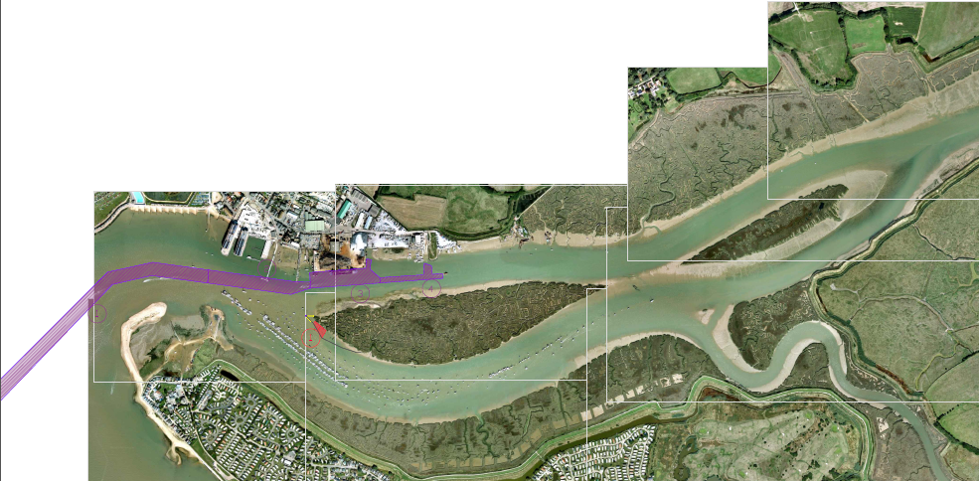
Using sediment as a resource
Year One (2016 – 2017)
Using Sediment As A Resource

Slide 5
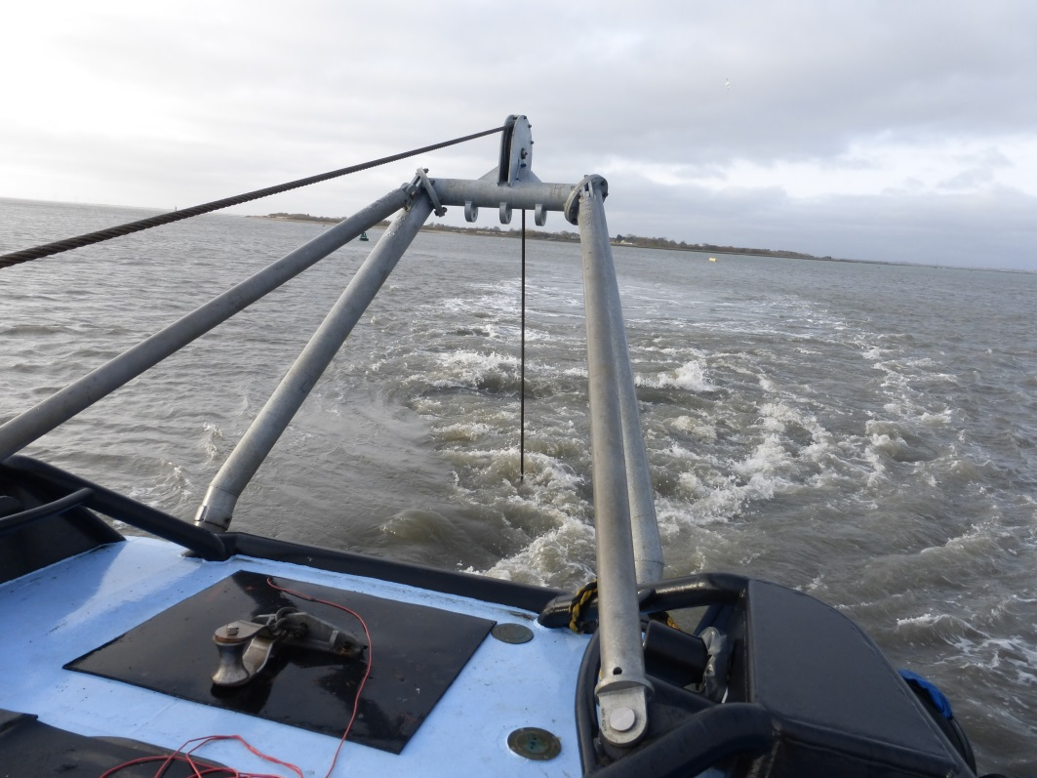
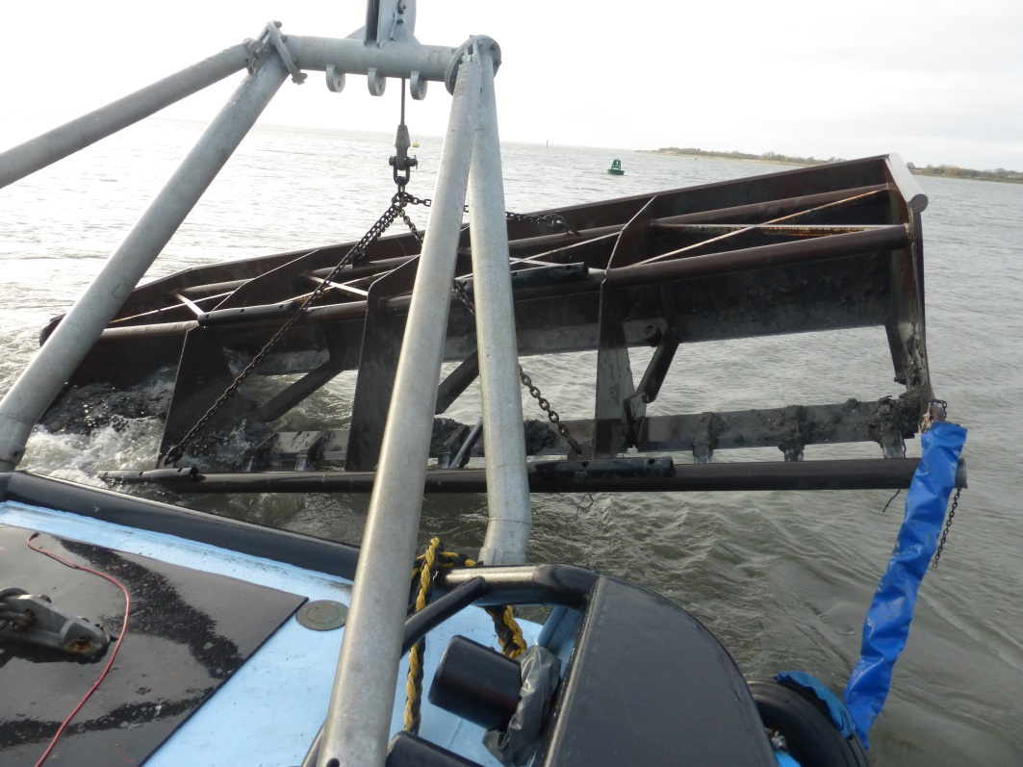
Using sediment as a resource
Main channel west
Using Sediment As A Resource

Slide 6
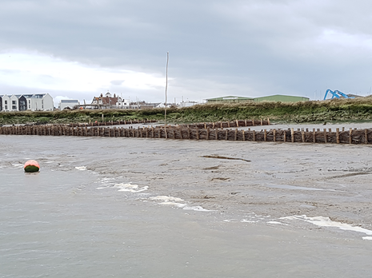
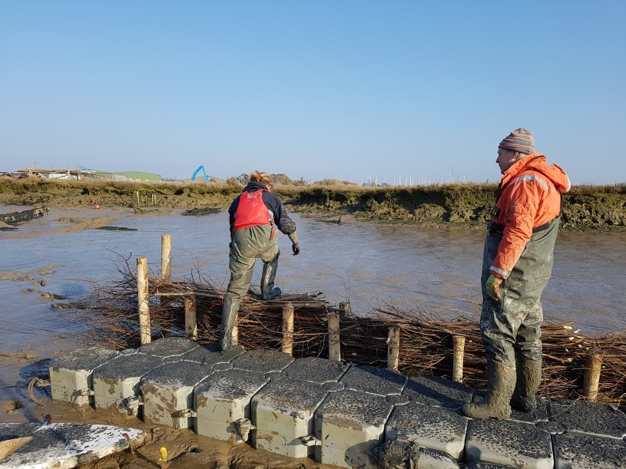
Using sediment as a resource
Trial sites
Using Sediment As A Resource

Slide 7
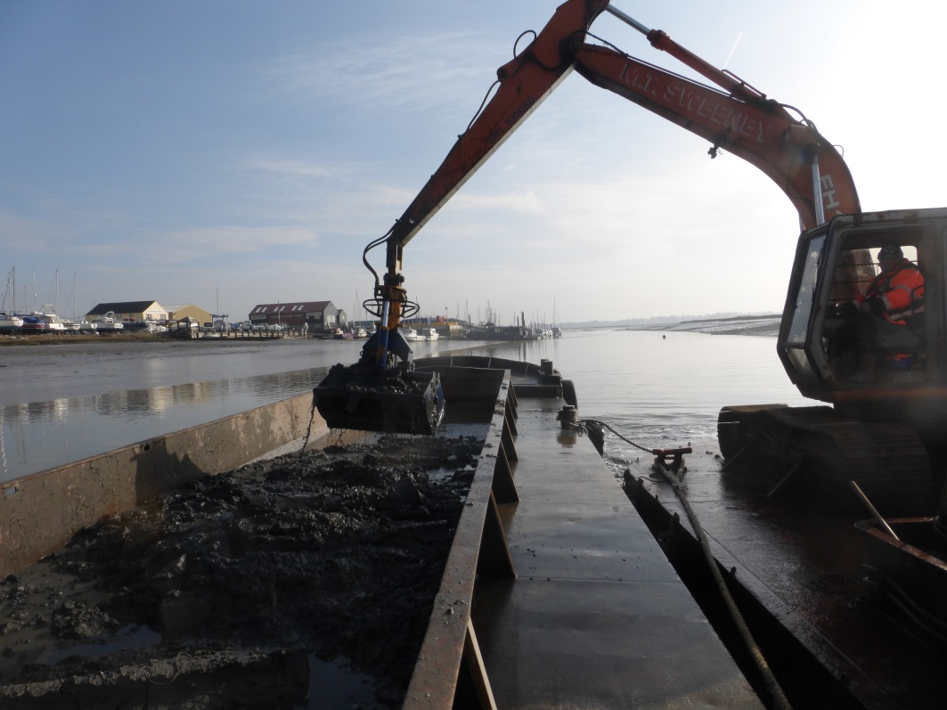
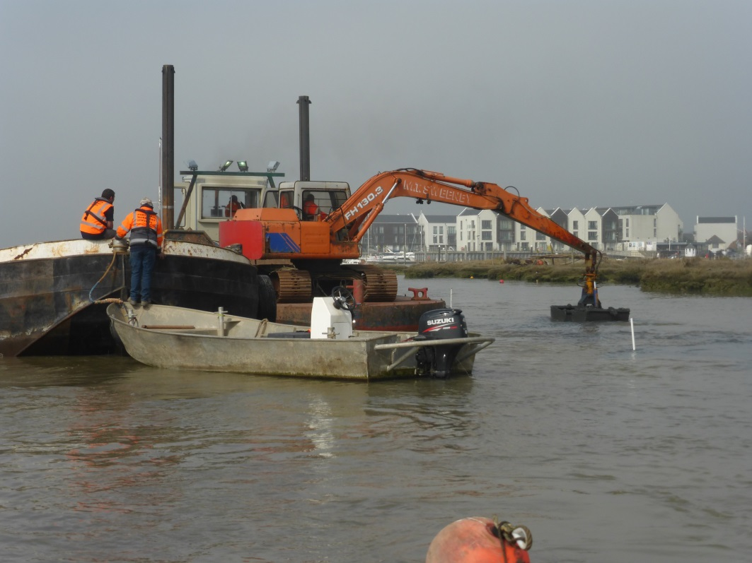
Using sediment as a resource
Trial sites
Using Sediment As A Resource

Slide 8
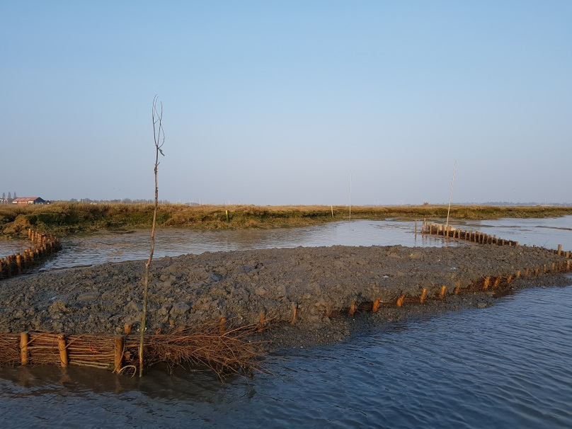
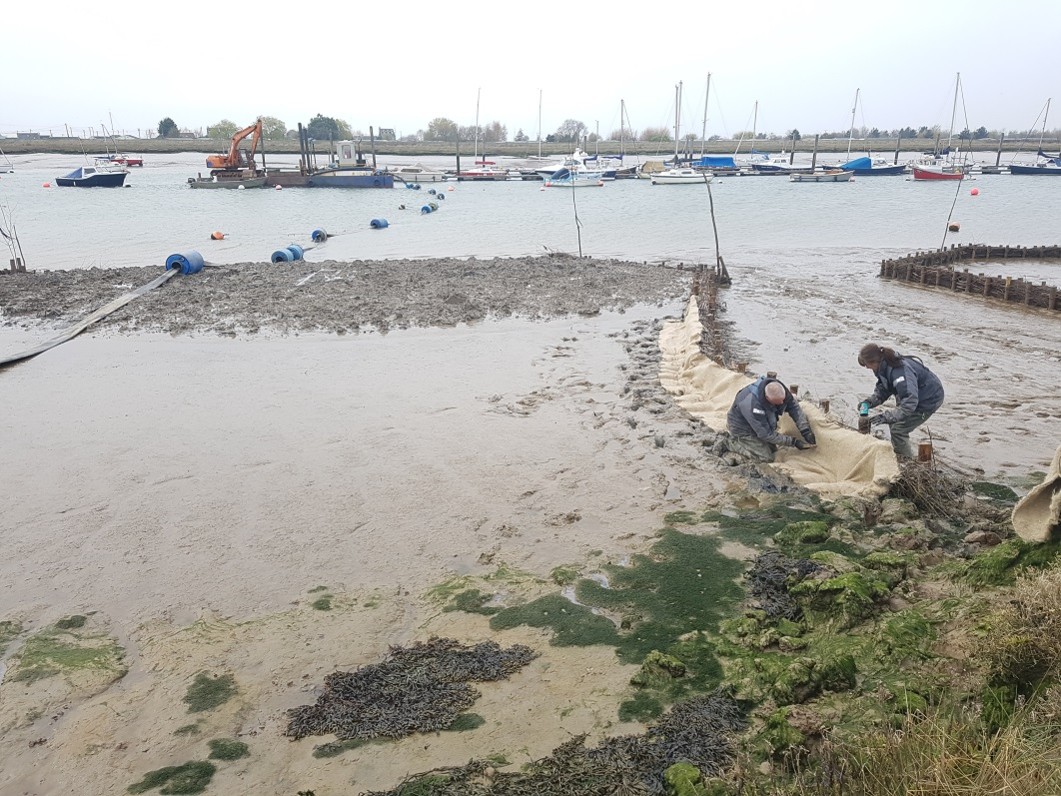
Using sediment as a resource
Trial sites
Using Sediment As A Resource

Slide 9
Using sediment as a resource
Monitoring and studies
Water quality monitoring
Bird monitoring
Vegetation monitoring
Benthic sampling
Sediment stability
Method trials
Pumping trial
Using Sediment As A Resource

Slide 10
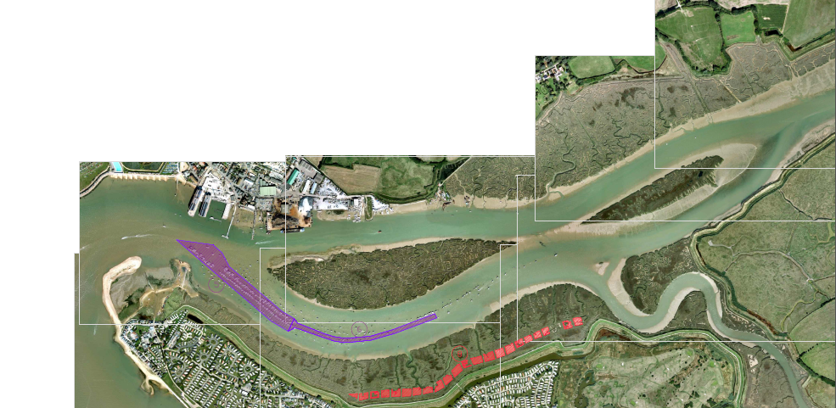
Using sediment as a resource
Year Two (2017 – 2018)
Using Sediment As A Resource

Slide 11
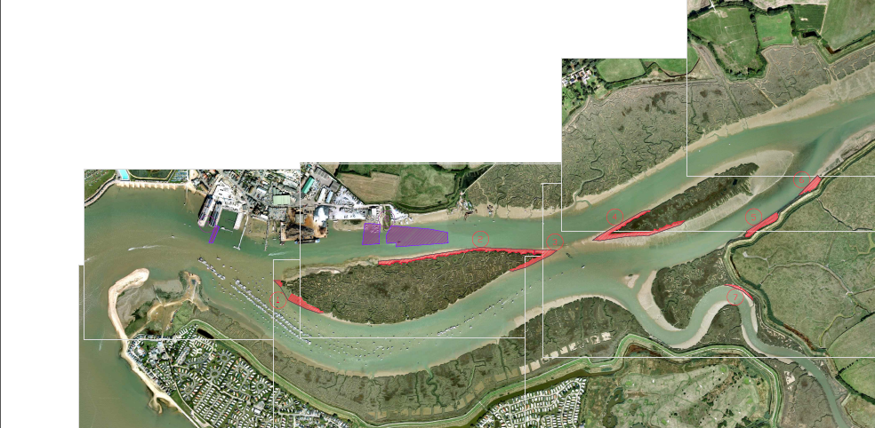
Using sediment as a resource
Year Three (2018 – 2019)
Using Sediment As A Resource

Slide 12
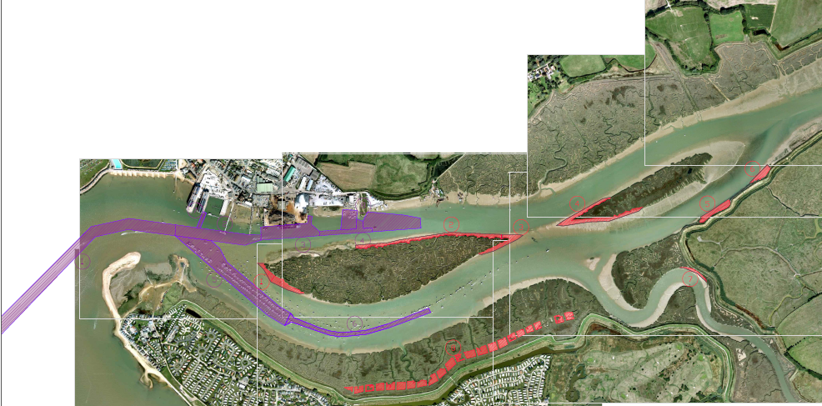
Using sediment as a resource
Year Four (2019 – 2020)
Using Sediment As A Resource

Slide 13
Using sediment as a resource
Thank you for your attention
Using Sediment As A Resource

